Slide 1
Responsive Design

Slide 2




Course Map
Getting Started
Front End
Back End
Advanced Topics
Fundamentals
Git
Command Line
HTML
CSS
Responsive Design
JavaScript & jQuery
Web Frameworks
Architecture
Database Design
APIs
Visualization
Security
Deployment

Slide 3
Front End Module - CSS
HTML
CSS & Responsive Design
JavaScript & jQuery

Slide 4
Agenda
What is responsive design?
Frameworks and tools
CSS3
Lab time!
Notes:
The quality of how far responsive design can go is dependent on how well we separate our storage, logic, and view.

Slide 5
What is Responsive?

Slide 6
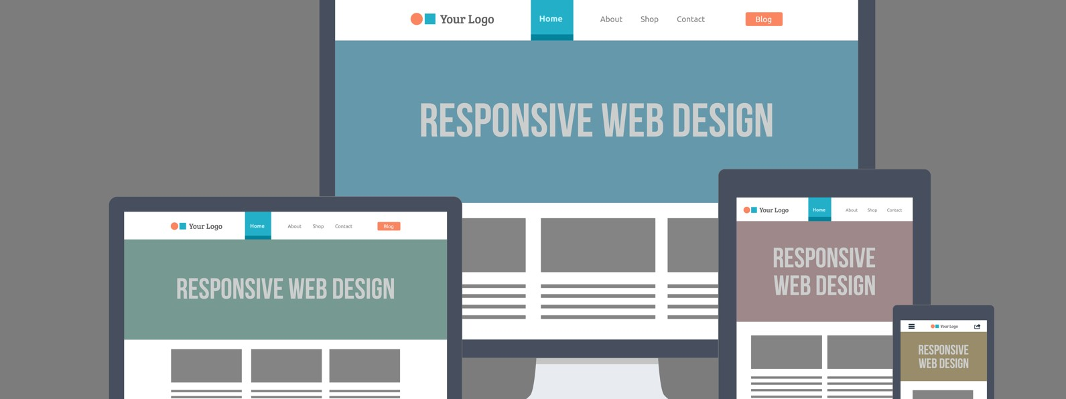
What is Responsive?
Responsive websites respond to their environment
Notes:
In simple terms, websites respond to the size of the browser window
The content never changes, only the presentation layer. We do this by dynamically using CSS based on various conditions that we set in our code.
This is possible because these web technologies have been built to have clear separation between the content and presentation layers.
https://www.usertesting.com/blog/2015/02/03/responsive-web-design-resources/
Image Source: http://artisantalent.com/wp-content/uploads/2015/04/embrace-responsive-web-design.jpg

Slide 7
Try it out
Check out some websites: nytimes.com, mozilla.org, cnn.com
How does the presentation change?
How many breakpoints are there?

Slide 8
How Do They Do it?

Slide 9
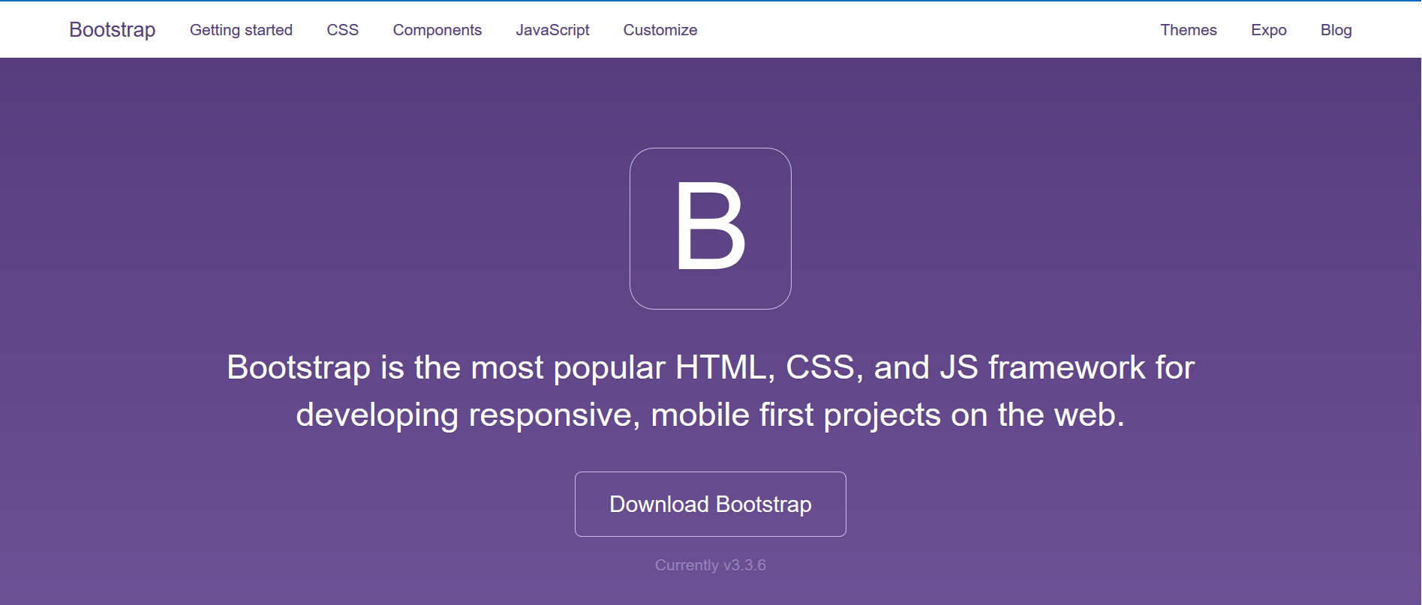
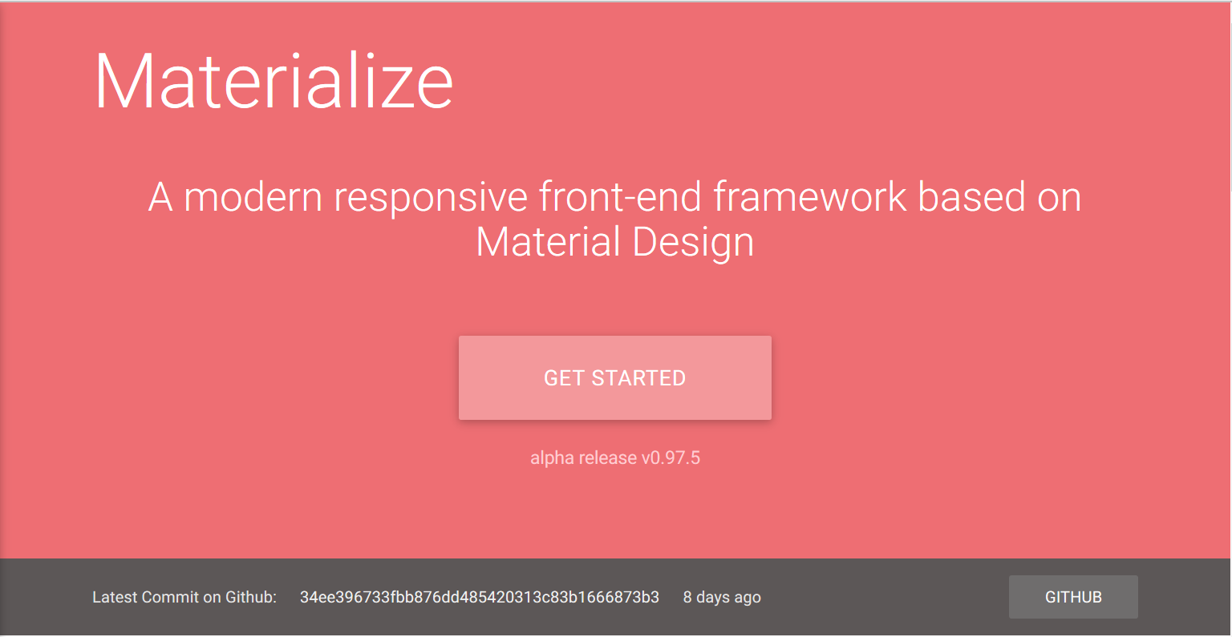
CSs Frameworks
Standardized set of practices
Address common problems
Common design patterns
Bootstrap
Materialize
Notes:
Most websites these days use some sort of CSS framework.
There are numerous frameworks, but all typically involve some predefined CSS as a standardized set of practices to address some common problems that you encounter in web design. Most CSS frameworks also help you easily design webpages that are optimized for different screen sizes.
One very popular CSS framework is Bootstrap. This was released by Twitter a few years ago to specifically address the issue of designing webpages for multiple screen sizes.
http://getbootstrap.com/
Google’s materialize is another CSS framework that is gaining popularity.
https://www.google.com/design/spec/material-design/introduction.html

Slide 10
CSS FrameWOrks
Pro
Quick Design
Grid Systems
Browser Support
Don’t reinvent the wheel
Con
Lots of unused code
“Bland” design
Notes:
CSS frameworks are great for most projects. They provide a lot of functionality and are easy to use once you follow the documentation.
We will be using them in future homeworks, but, to understand how to build responsive websites, we will try to do it through plain html and css, which can be pretty powerful.

Slide 11
Building Blocks

Slide 12
Viewport
Visible area of the webpage
Tells the browser to use the device width
Not all pixels are the same
Browsers try to scale things
Notes:
Demo: Show how the browser show the page with the viewport meta tag and without.

Slide 13
Media Queries
“Media queries, added in CSS3, let the presentation of content be tailored to a specific range of output devices without having to change the content itself.”
Mozilla Developer Network
Dig Deeper
Notes:
Read the W3 recommendation for media queries here: https://www.w3.org/TR/css3-mediaqueries/.

Slide 14
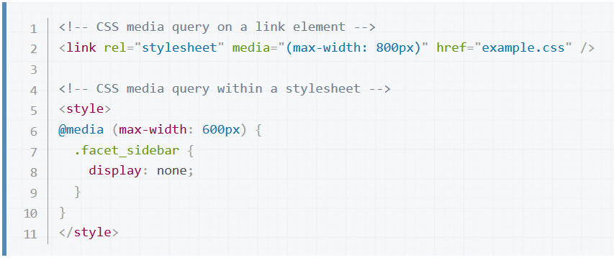
Media Queries
Notes:
Media queries look something like this.
Just regular CSS code, with the only new syntax being the @media.

Slide 15
Media Queries - Syntax
Notes:
Media queries look something like this.
Just regular CSS code, with the only new syntax being the @media.

Slide 16
Media Queries – Criteria
Notes:
This is the criteria to check for when the CSS should be loaded.
There is a list of other things that you can use as your criteria.

Slide 17
Media Queries – Option 1
Notes:
There are two ways to use media queries
Option 1: is to link to a stylesheet that will only be loaded when it meets the criteria.
https://developer.mozilla.org/en-US/docs/Web/CSS/Media_Queries/Using_media_queries

Slide 18
Media Queries – Option 2
Notes:
There are two ways to use media queries
Option 2: it to include the style in the same sheet but to create a block that will only be used when the criteria is met.
https://developer.mozilla.org/en-US/docs/Web/CSS/Media_Queries/Using_media_queries

Slide 19
Breakpoints
Viewport size where the layout changes (new CSS style loaded)
2-3 breakpoints for most sites

Slide 20
Layout Strategies

Slide 21
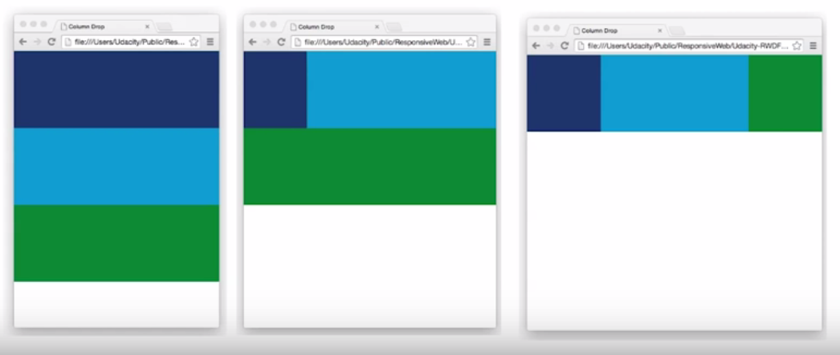
Column Drop
Notes:
Elements stack in smaller views.
As the viewport gets wider, they take advantage of the extra real estate.
You do this by setting the outer div (container) to display: grid; and flex-wrap: wrap;
You set 3 breakpoints

Slide 22
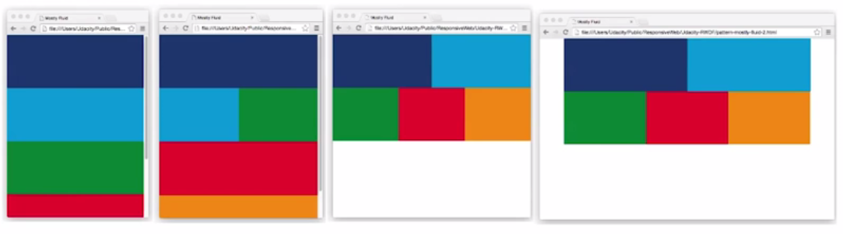
Mostly Fluid
Notes:
Usually, at the biggest, there are margins to avoid having a lot of side to side real estate.

Slide 23
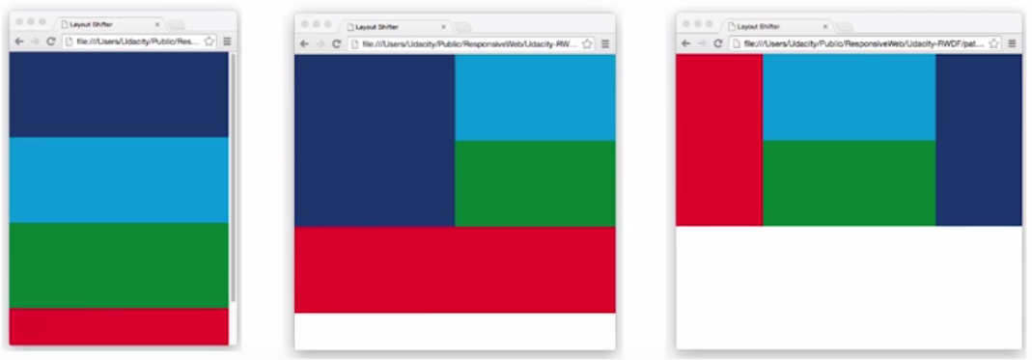
Layout Shifter

Slide 24
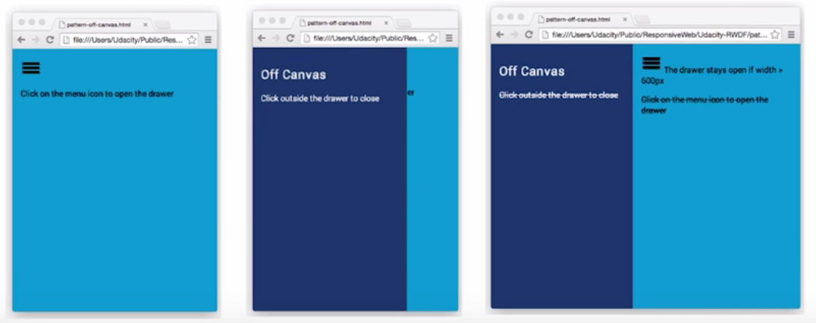
Off Canvas

Slide 25
Responsive Strategies
Mobile First
Start with your smallest design first
Prioritize Functionality
Minimize bells and whistles
Sketch your layouts
Figure out breakpoints
Highlight most important content

Slide 26
Lab

Slide 27
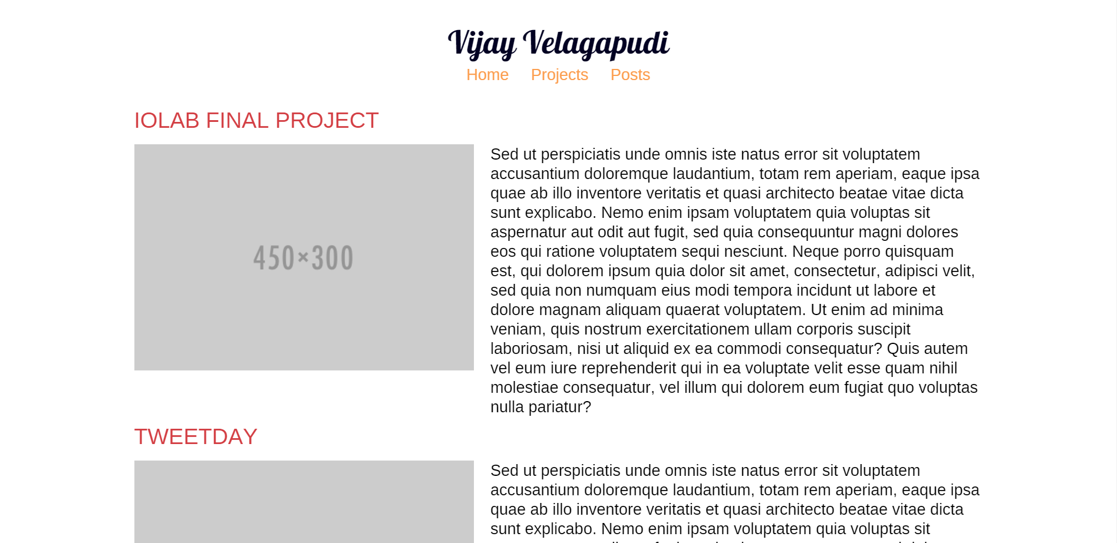

Slide 28
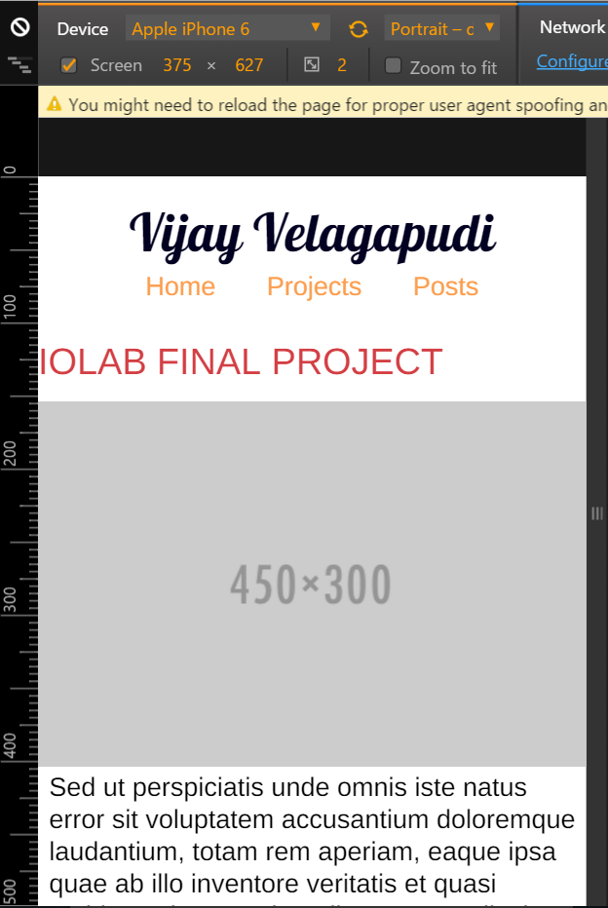
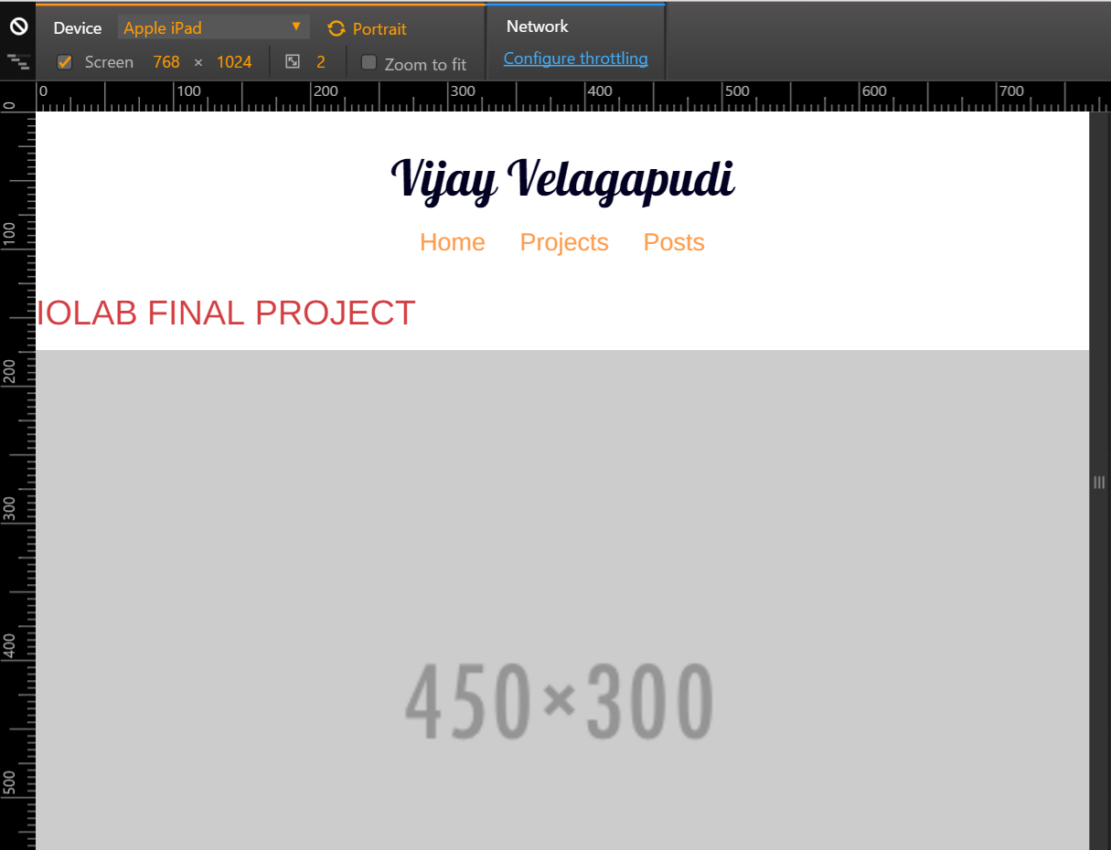

Slide 29
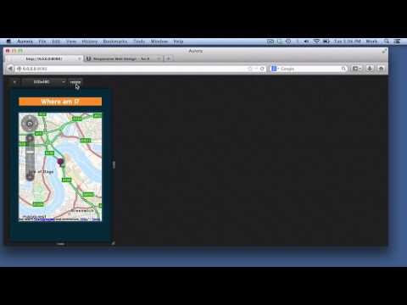
Responsive Design View - Video
Notes:
Browsers can help you see how a website looks on various screen sizes. This is an essential tool to allow you to design and debug your own websites.
https://youtu.be/LBcE72sG2s8

